Slide 1
Work Update: Ophiuchus with DR 2
May 7, 2018

Slide 2
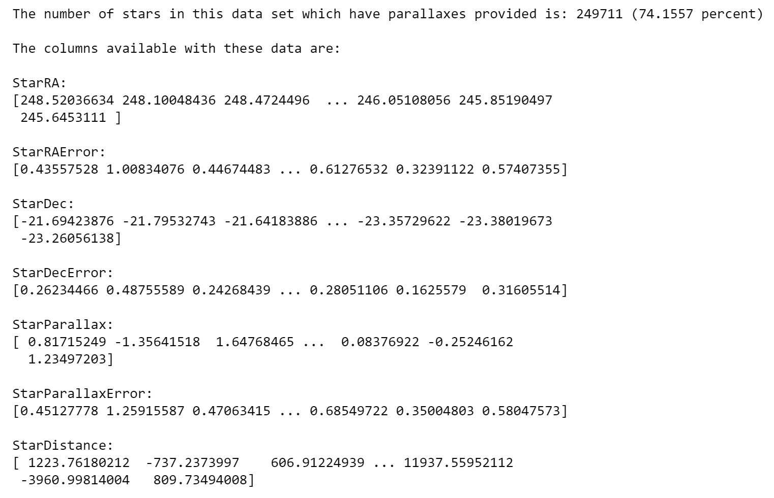
General Information and Data

Slide 3
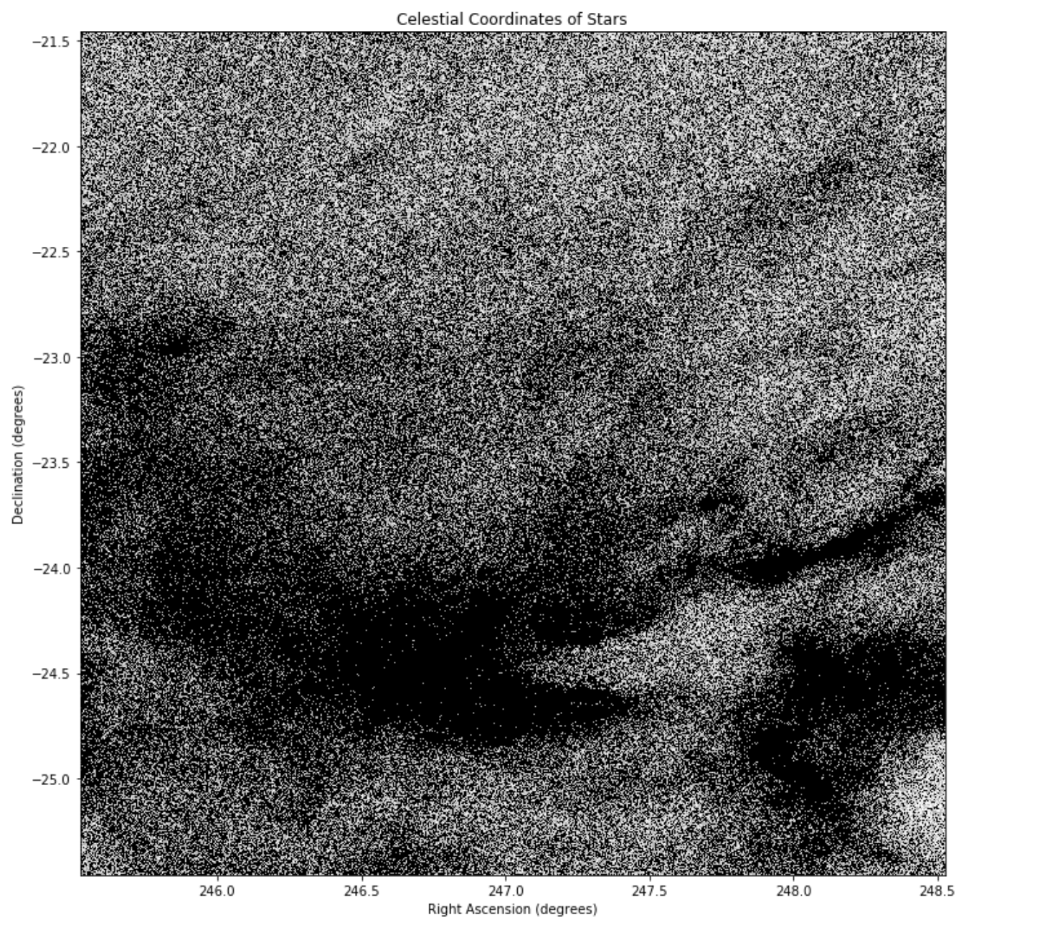
Sky Plot (RA/Dec Locations)

Slide 4
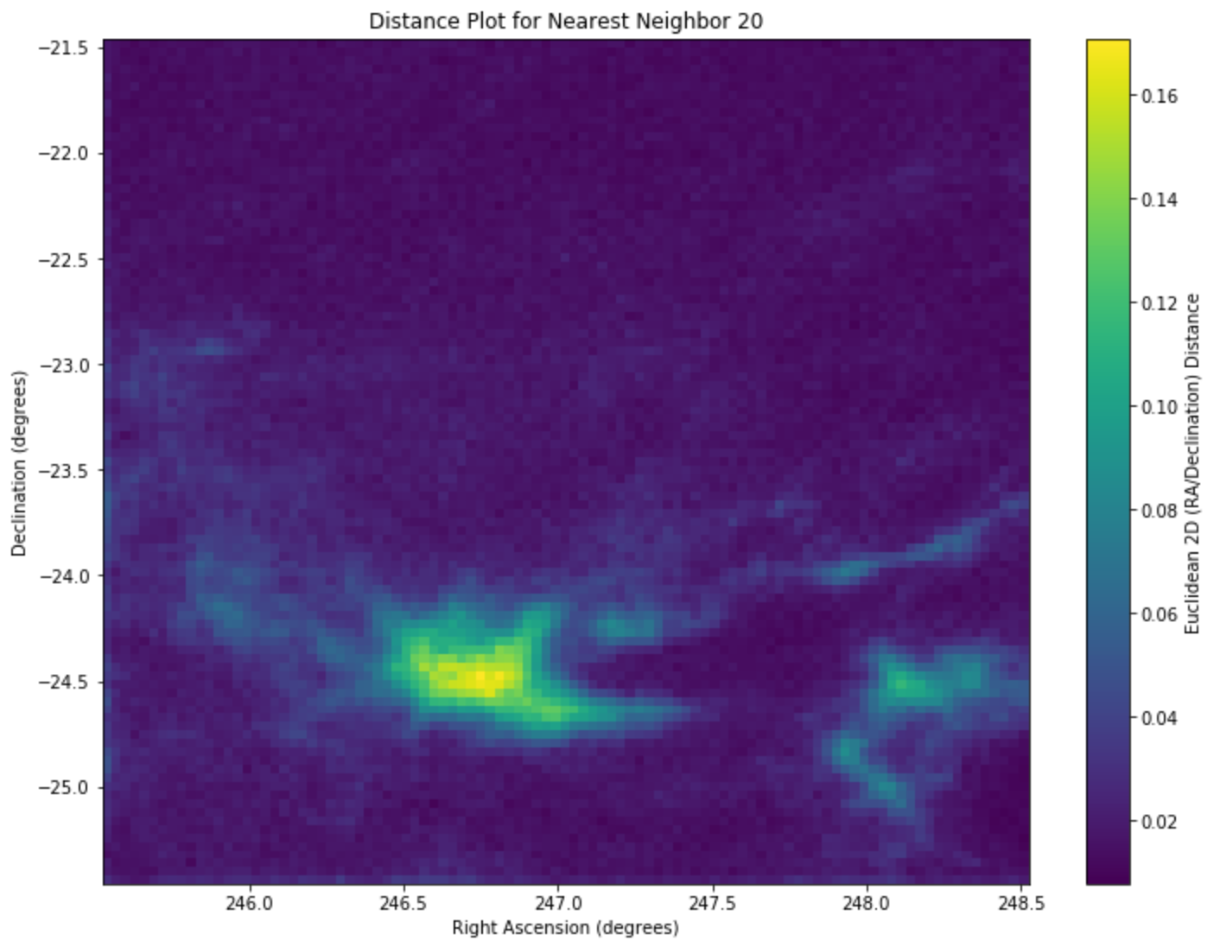
2D (RA/Dec) Distance Map (k=20)

Slide 5
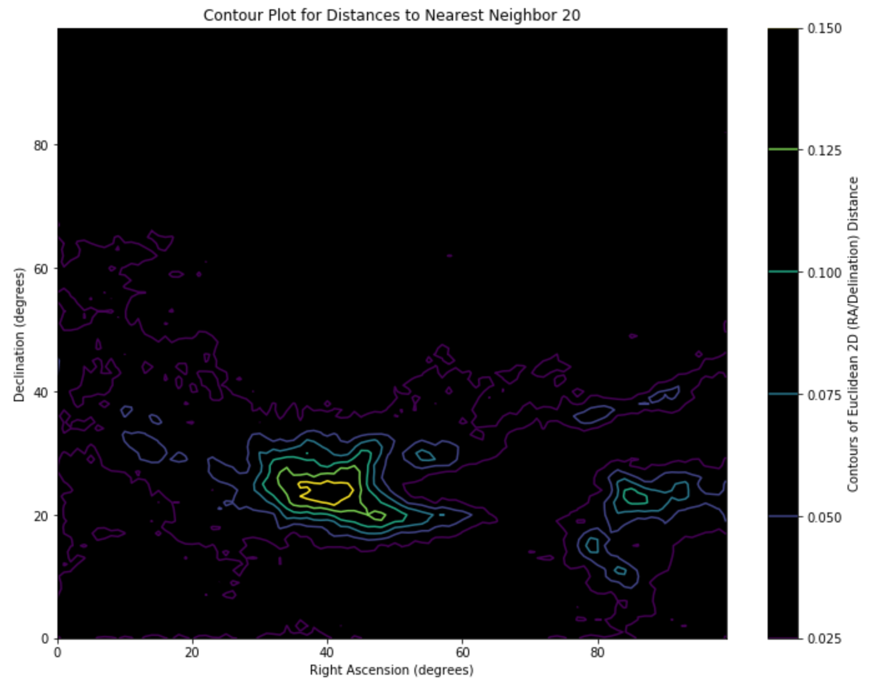
2D (RA/Dec) Contour Plot

Slide 6
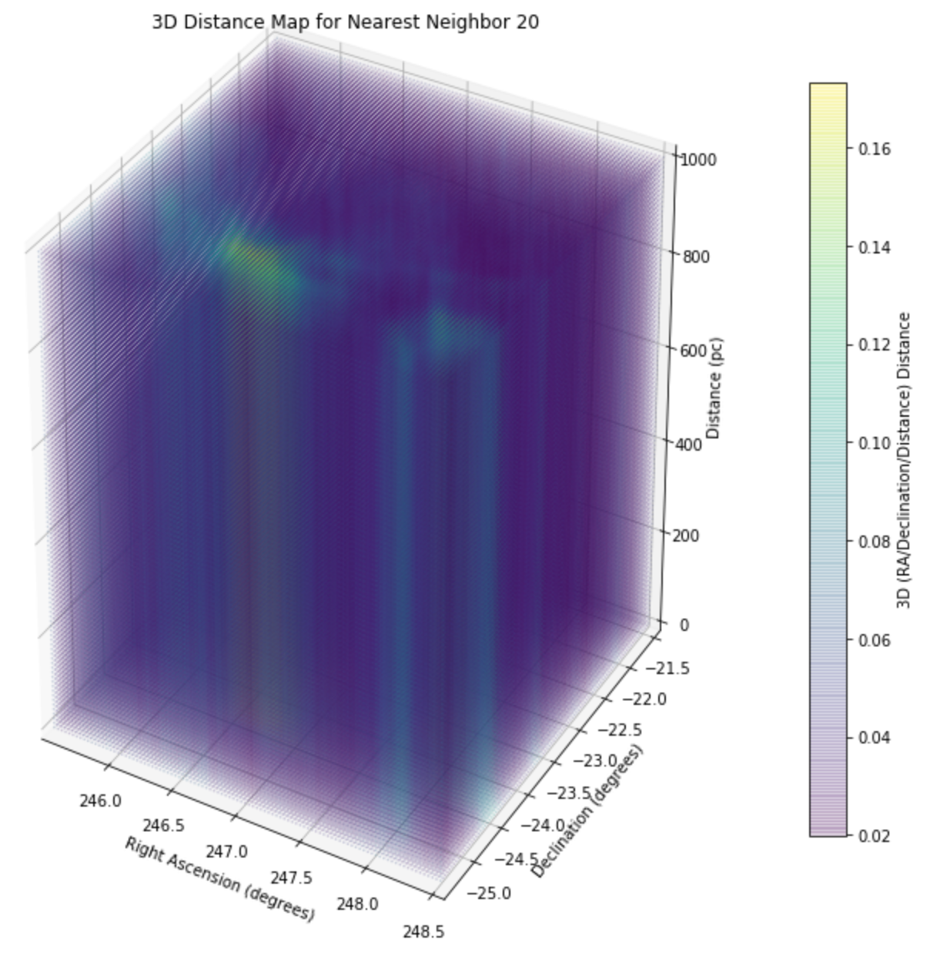
3D Distance Map

Slide 7
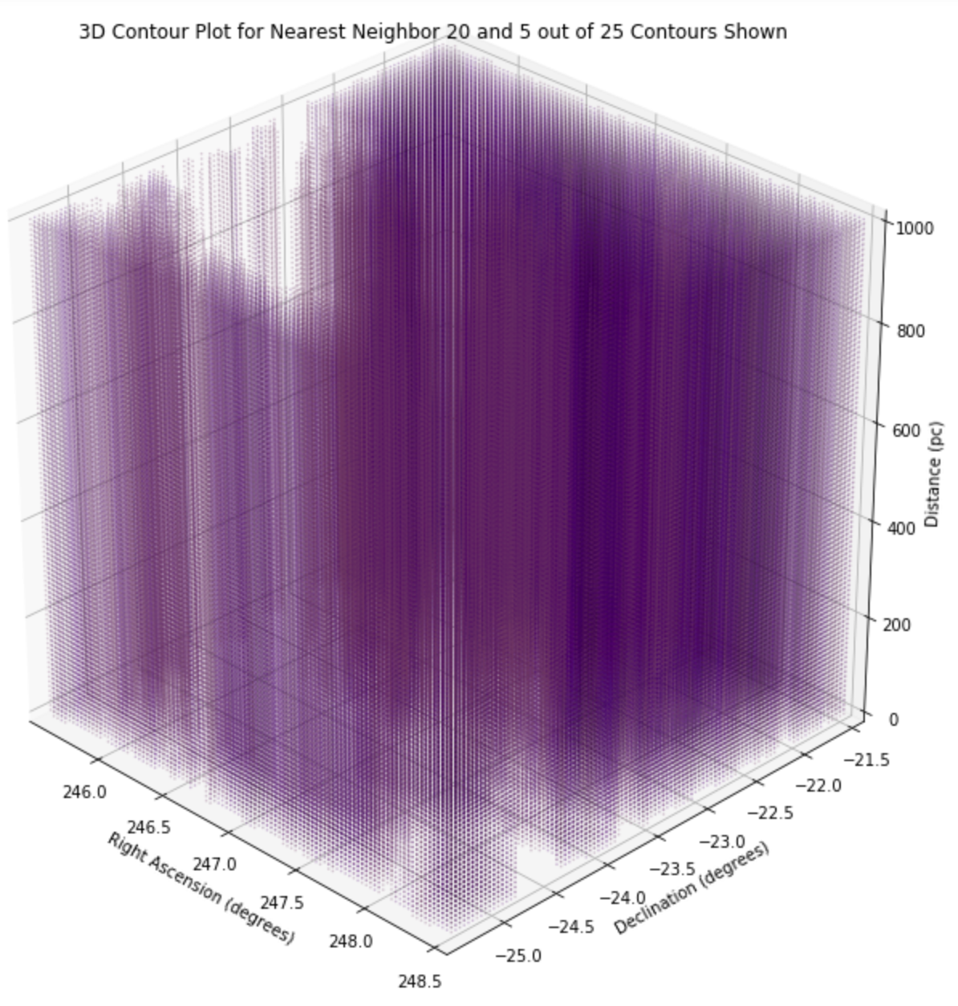
3D Contours (5/25)

Slide 8
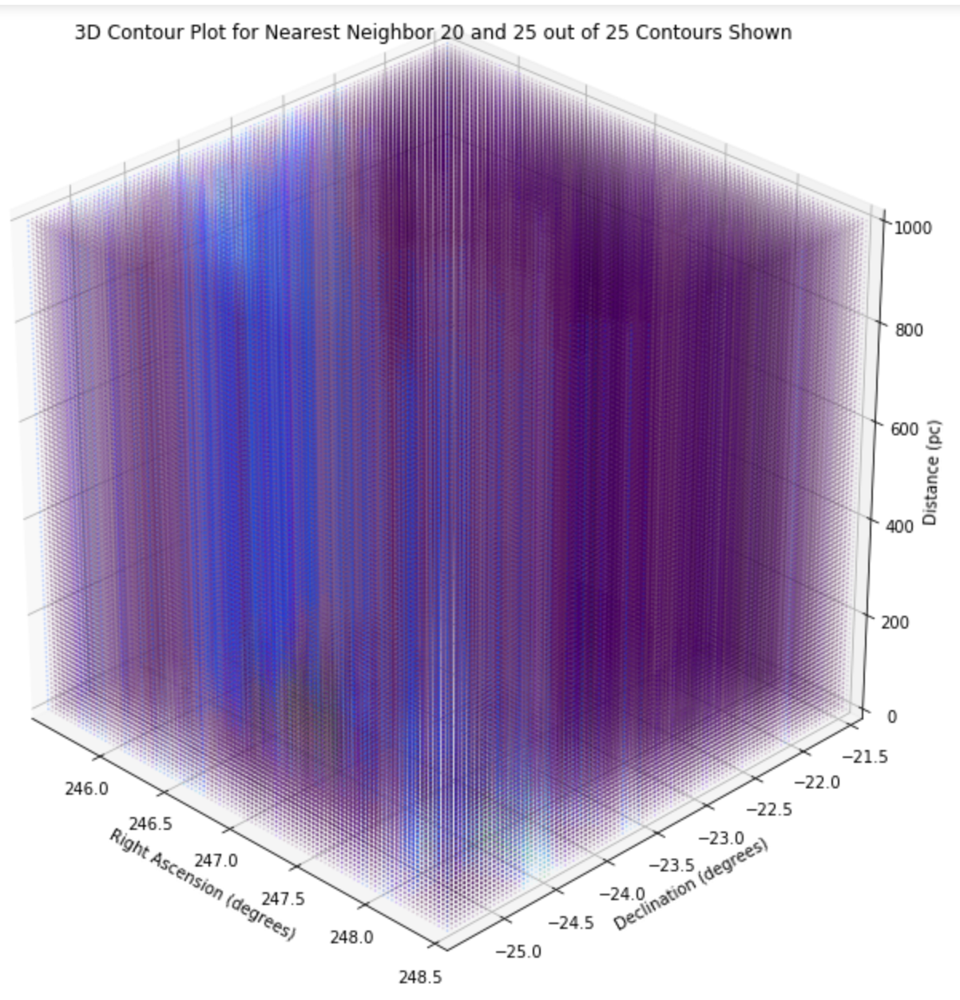
3D Contours (25/25)

Slide 9
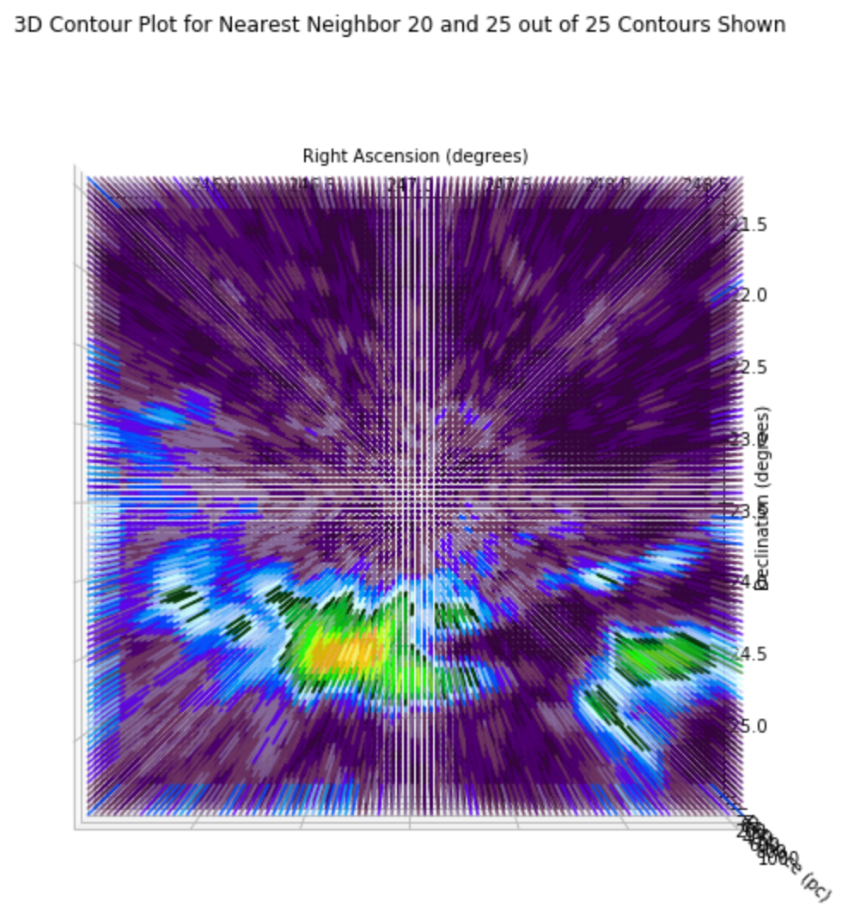
Top View 3D Contour Plot (25/25)

